Slide 1
Books
BEHAVIORAL MATHEMATICS FOR GAME AI – By Dave Mark
Designing Games – Sylvester

Slide 2
BOARD GAMES – to be played and analysed in class
Chess
Ludo
Chinese checker
Snakes & ladders
Checkers
Scrabble
Mancala
Othello

Slide 3
“All the world's a stage,
And all the men and women merely players; They have their exits and their entrances, And one man in his time plays many parts, His acts being seven ages….”
Extending this to the world as it is now
All the world is a game space
And all animals merely players;
They each have a role and a set of rules forced on them,
And each in his/her time plays only one role,
His/her acts are isomorphic and so predictable
Rule breakers are ostracized ….

Slide 4
Game: Theory of fun?

Slide 5
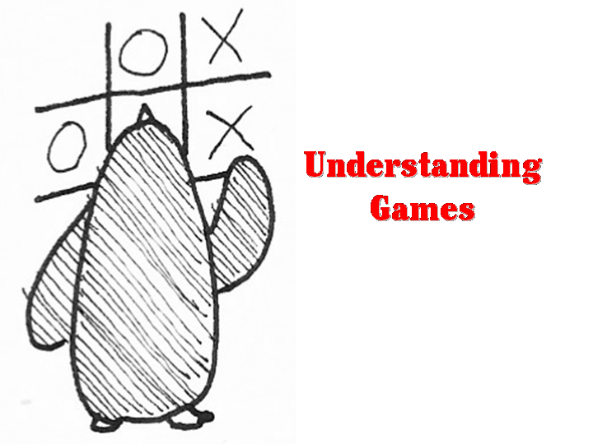
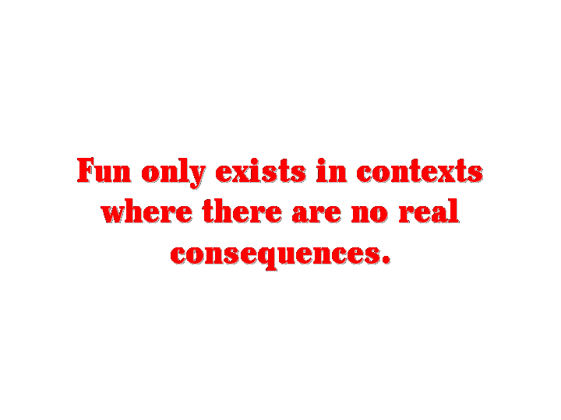
What is fun?
Generically, “ a source of enjoyment.”
The release of endorphins into your system
- also released by chocolate, great books, driving…
The feedback the brain gives us for absorbing patterns for learning purposes
http://www.theoryoffun.com/tfall.shtml

Slide 6
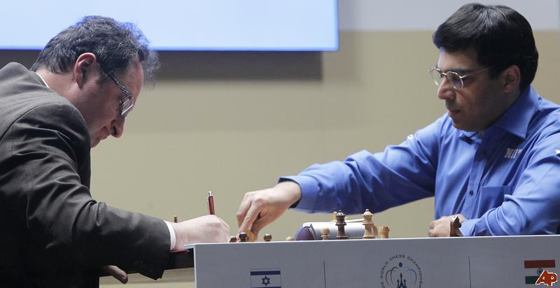
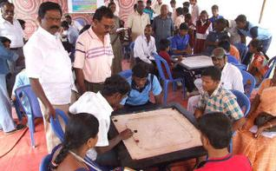
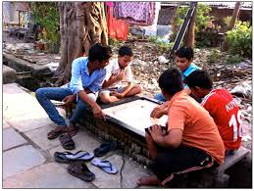

Slide 7
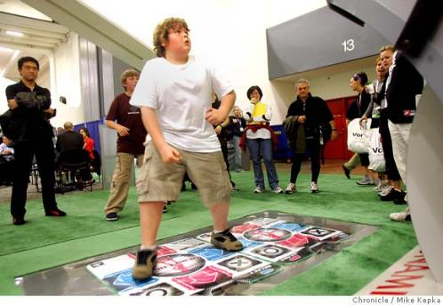
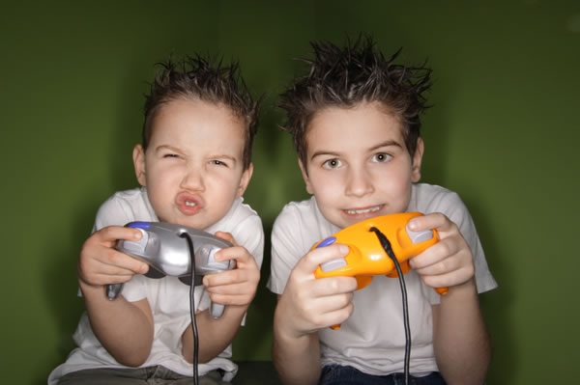
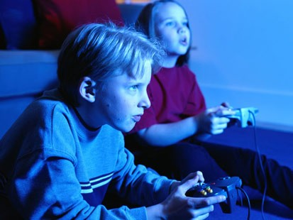
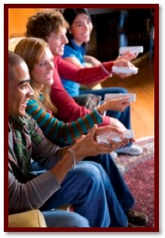

Slide 8
Some theories on Fun from games - competition and fun?
when players compete with players of lower skill levels , they report higher levels of enjoyment and lower levels of arousal after game playing
When players compete with players of similar skill levels, they apply more effort as indicated by more games played and longer duration of play.
Self-determination theory suggests that activities, such as games, are enjoyable because they satisfy people’s intrinsic psychological needs to feel competent, autonomous, and connected to others.
Games can also create a state of flow, which is described as being so totally involved that people lose their self-consciousness and sense of time.
competition emerges as a key element in the appeal of games.

Slide 9
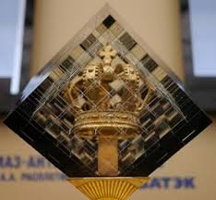
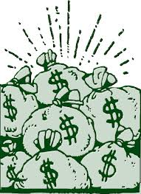
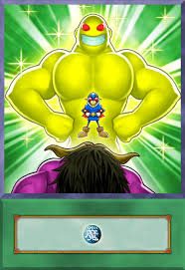
FUN < or >
Single player
Multi-player
Self-driven
Not judged
Minimal effect on self-esteem
Engaging
Lower social/peer pressure
Competitive
Sense of being judged
Can effect self-esteem
Highly engaging
High social pressure
GAME ➔ HONOR/REWARD/POWER

Slide 10
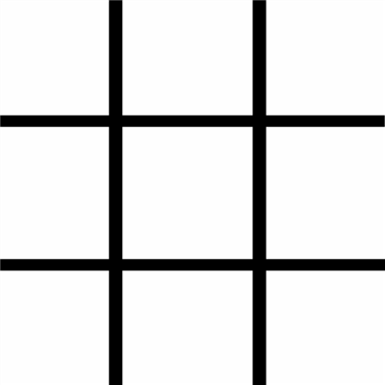
What’s fun is exercising your brain

Slide 11
Games are puzzles
X

Slide 12
—they are about cognition
O
X

Slide 13
---and learning to analyze patterns
X
O
X

Slide 14
--- When you’re playing a game, you only play it..till you master it!
X
O
X
X
O
X

Slide 15
--- Once you master it..it gets boring!
X
X
O
X
X
O
X
X
O
X
X
O
X
O
X
X
X
O
X
X
O
O
X
X
X
O
O
X
O
X
O
X
X
X
O
X
X
O
X
X
O
X
X
O
X
X
O
X
X
O
O
X
O
X
O
X

Slide 16
--- Basically, all games are edutainment
This game sucks!!!!
X
X
O
X
X
O
X
X
O
X
X
O
X
O
X
X
X
O
X
X
O
O
X
X
X
O
O
X
O
X
O
X
X
X
O
X
X
O
X
X
O
X
X
O
X
X
O
X
X
O
O
X
O
X
O
X

Slide 17
Discussion:
are games actually fun or is it the media that keeps us engagement?
Is it +ve social interactions that make the game fun?
Is intense engagement fun for all? Or is it subjective?
Or fun dependent on consequences?

Slide 18
Board games – a history trip

Slide 19
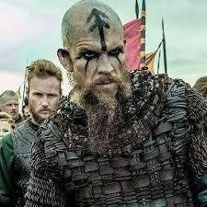
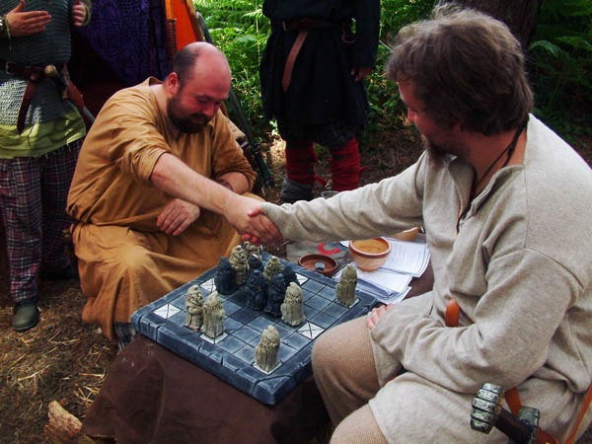
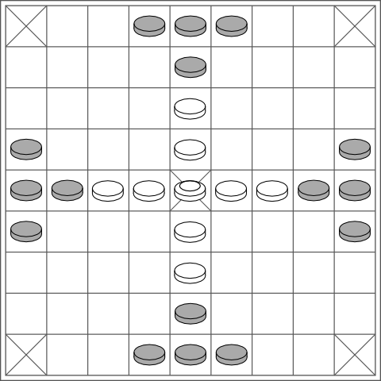
Tafl
Tafl was a very popular game among the Vikings. One player aims to get his king from the centre of the board to the edges, while the other does everything he can to capture him.
(Assignment: Read about the game THUD)

Slide 20
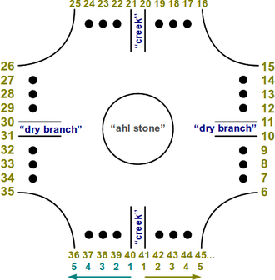
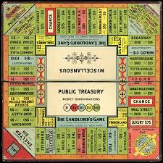
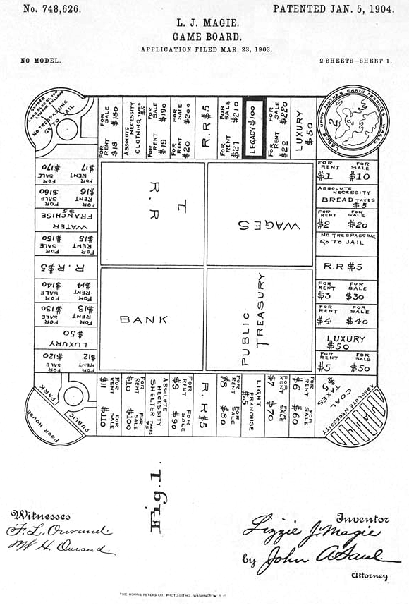
The Landlord’s Game
The Landlord’s Game was invented in 1903 by Maryland actress Lizzie Magie. The game board consisted of a square track, with a row of properties around the outside that players could buy.
Interesting: anti-monopolist and a monopolist- 2 games in one.
Zohn Ahl

Slide 21
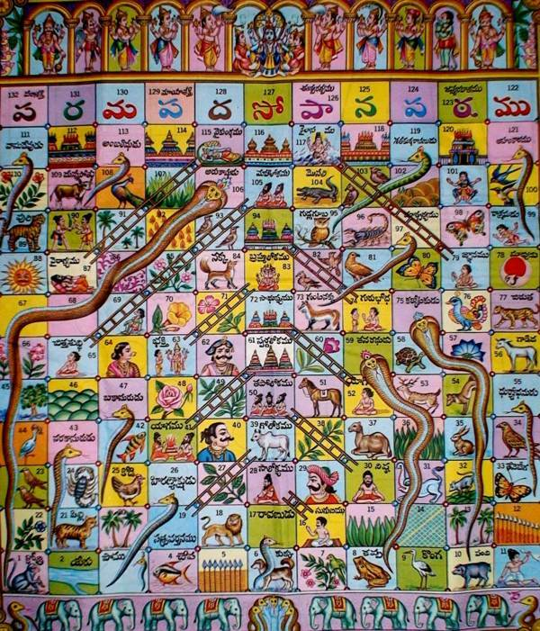
Vaikuntapaali/Moksha Patam/Mokshapat
The sixteenth century Indian game of Vaikuntapaali—also known as Leela—was a tool for teaching morality and spirituality.

Slide 22
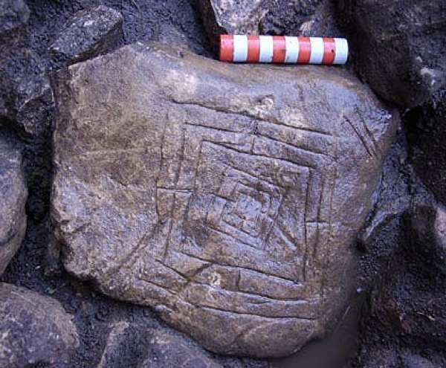
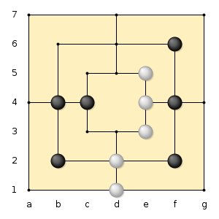
Nine Men’s Morris
A precursor to Tick-Tack-Toe, Nine Men’s Morris is a game in which counters are placed on a grid with the aim of creating lines of three. Once all the pieces are down, they can be moved one space per move.

Slide 23
Assignment discussion
THUD – Can we quickly discuss this game and align it to current political/media/social wars !
Royal game of UR

Slide 24
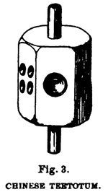
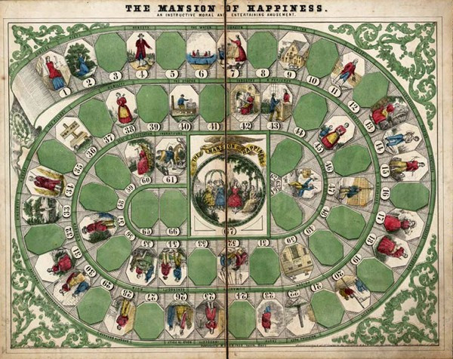
The Mansion of Happiness
The board consisted of a basic roll-and-move track—saturated with more Puritanism than should rightfully fit on a piece of cardboard. Sabbath-breakers are sent to the whipping post (whips sold separately), and the vice of Idleness will land you in Poverty.
"WHOEVER possesses PIETY, HONESTY, TEMPERANCE, GRATITUDE, PRUDENCE, TRUTH, CHASTITY, SINCERITY...is entitled to Advance six numbers toward the Mansion of Happiness. WHOEVER gets into a PASSION must be taken to the water and have a ducking to cool him... WHOEVER posses[ses] AUDACITY, CRUELTY, IMMODESTY, or INGRATITUDE, must return to his former situation till his turn comes to spin again, and not even think of HAPPINESS, much less partake of it.”
Source: Jensen, Jennifer. "Teaching Success Through Play: American Board And Table Games, 1840–1900". Magazine Antiques, December, 2001.

Slide 25
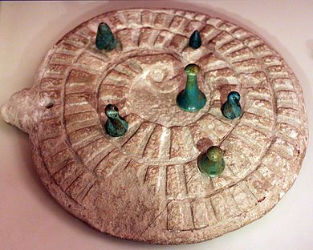
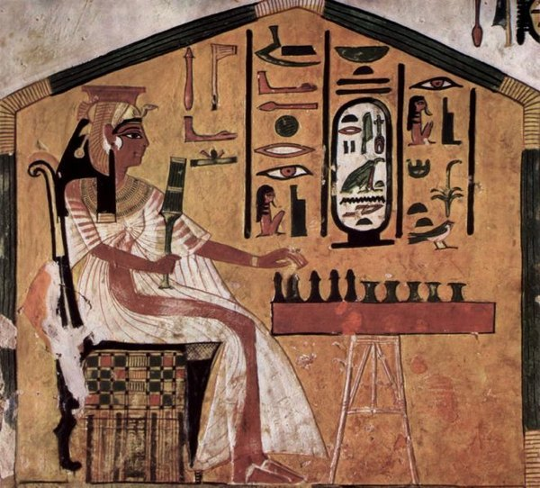
Senet
Mehen
3000 BCE
In Egypt, the gameboard depicts a coiled snake whose body is divided into rectangular spaces
In Cyprus and the Levant, the games take the form of a spiral of depressions, sometimes with the central or outer depressions differentiated by their larger size. These also display a variable number of depressions. The variability suggests that the number of segments was of little importance to the game. Objects associated with the board may or may not be playing pieces.
From archaeological evidence, the game seemed to have been played with lion- or lioness-shaped pieces, in sets of three or as many as six, and a few small spheres
Senet is the oldest board game known to exist. Sets have been found in burial chambers from as far back as 3,500 B.C.—including four in Tutankhamen’s tomb. Game boards were three squares wide and ten squares long, and sets typically had five to seven pieces for each player. Though the original rules have been lost, there is general consensus that the aim is to race one’s pieces across the board, using thrown sticks as an equivalent for dice.
(History of Games, Wiki)

Slide 26
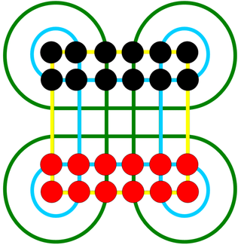
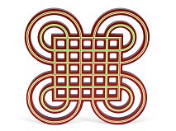
Surakarta - Indonesian

Slide 27
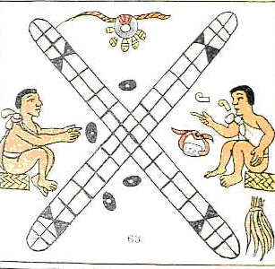
Patolli
Anthropologist E. Adamson Hoebel (1966) says the Aztec patolli derives from the East Indian game of pachisi but R.B. Lewis of the Department of Anthropology at the University of Illinois (1988) says that the similarity between the two games is due to the limitations of a board game meaning the two games were independently derived.
Patolli is a race/war game with a heavy focus on gambling. Players would meet and inspect the items each other had available to gamble. They bet blankets, maguey plants, precious stones, gold adornments, food or just about anything. In extreme cases, they would bet their homes and sometimes their family and freedom
pre-Columbian Mesoamerican cultures

Slide 28
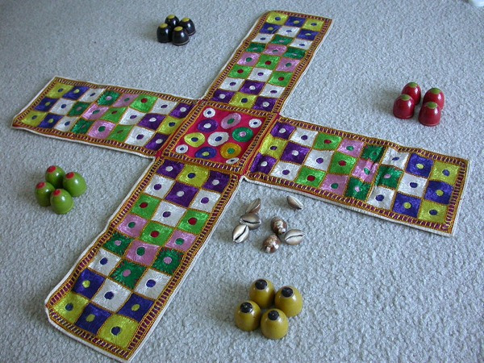
Chaupat
The Indian game of Chaupat and the closely-related game Pachisi are the original cross-and-circle games, of which the best known example in the West is the much-simplified Ludo.
Players aim to race their pieces around the board, with moves determined by a throw of cowry shells.
An opponent’s pieces can be captured by landing on the same square, and two of a player’s pieces on the same square can merge into a “super-piece”.

Slide 29
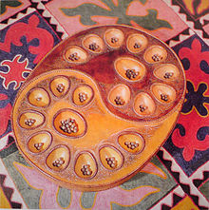
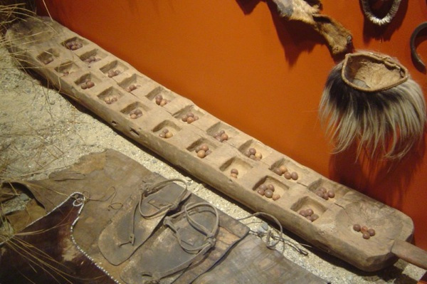
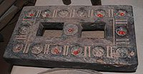
Mancala
Mancala refers to a family of games with the same basic method of play. Known as count-and-capture games, there is some evidence to suggest that they may be the earliest games played—predating even Senet
Pallanghuzi

Slide 30
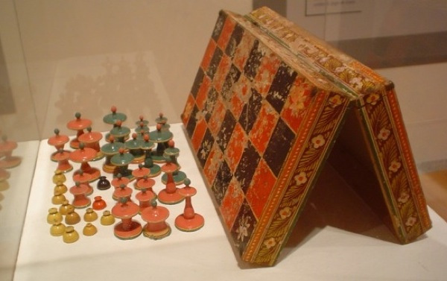
Chaturanga
Chaturanga—which dates from as far back as the seventh century A.D.—is the common ancestor of all the modern versions of chess. The board and most pieces are the same, though the exact rules are sadly forgotten.

Slide 31
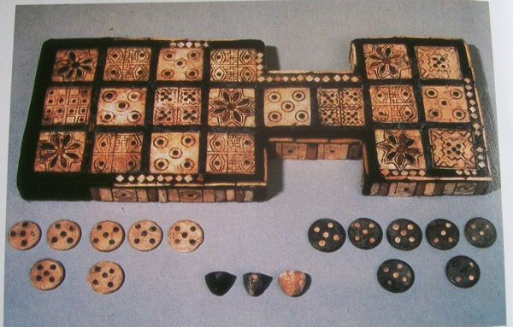
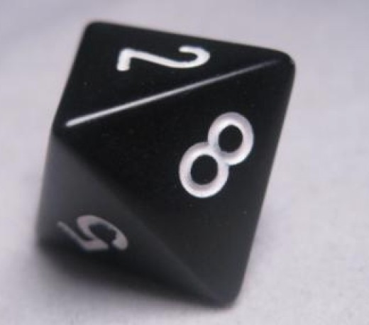
The Royal Game of Ur
The Royal Game of Ur is the oldest-known board game for which the original rules survive. The oldest sets, discovered in Iraq in the 1920s, date to around 2600 B.C. The game had been thought long-dead—superseded by backgammon 2000 years ago
(Assignment 1: play this game at http://www.mesopotamia.co.uk/tombs/challenge/cha_set.html)

Slide 32
History of computer games

Slide 33
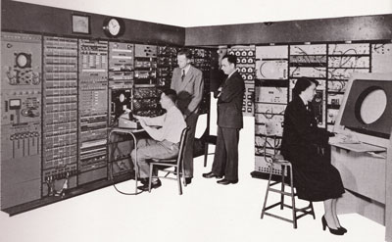
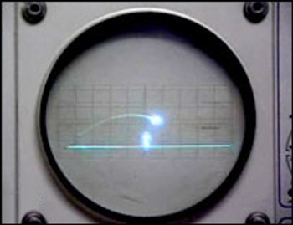
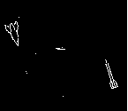
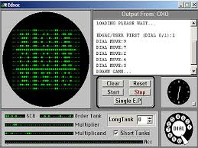
Computer games
In 1949–1950, Charley Adama created a "Bouncing Ball" program for MIT's Whirlwind computer.
In February 1951, Christopher Strachey tried to run a draughts (checkers) program he had written for the Pilot ACE (by Turing).
OXO, a graphical version of tic-tac-toe, was created by A.S. Douglas in 1952 at the University of Cambridge.
In 1958 William Higinbotham created a game using an oscilloscope and analog computer. Titled Tennis for Two.
Around 1962, the game space war was developed at MIT.

Slide 34
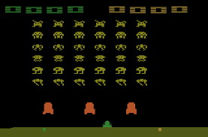
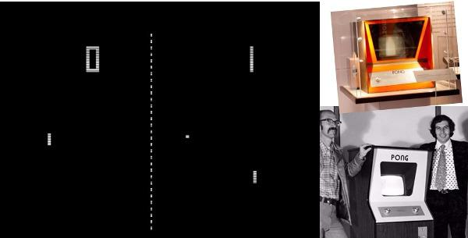
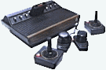
First Commercial game
Space Invaders 1977
Pong (Atari 1973)
Was making $40 a day!!
https://www.youtube.com/watch?v=D1jZaIPeD5w
Atari VCS 2600, the first popular home computer game system. (1977)

Slide 35
Text games
Adventure (Crowther & Woods 1977)
Welcome to Adventure!
[...]
At End Of Road
You are standing at the end of a road before a small brick building.
Around you is a forest. A small stream flows out of the building and down a gully.
>enter building
Inside Building
You are inside a building, a well house for a large spring.
There are some keys on the ground here.
There is tasty food here.
There is a shiny brass lamp nearby.
There is an empty bottle here.
>get lamp
Taken.
Play online a text game called ‘ZORK’

Slide 36
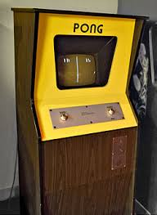
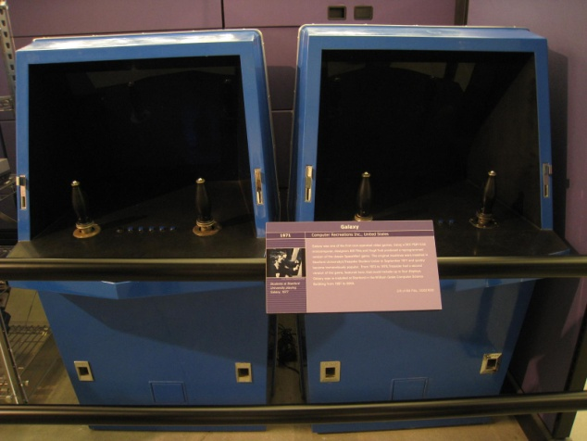
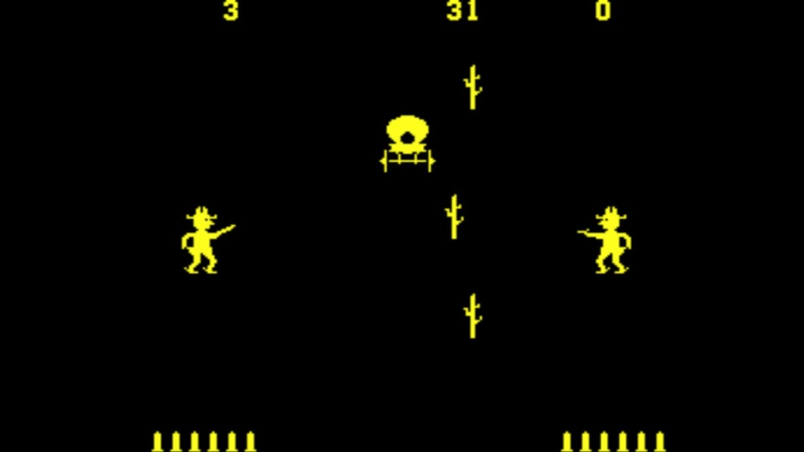
Arcade games
In September 1971, Galaxy Game was installed at Stanford University.
Bushnell and Dabney founded Atari, Inc. in 1972, before releasing their next game: Pong.
Another significant game was Gun Fight, an on-foot, multi-directional shooter, designed by Tomohiro Nishikado and released by Taito in 1975

Slide 37
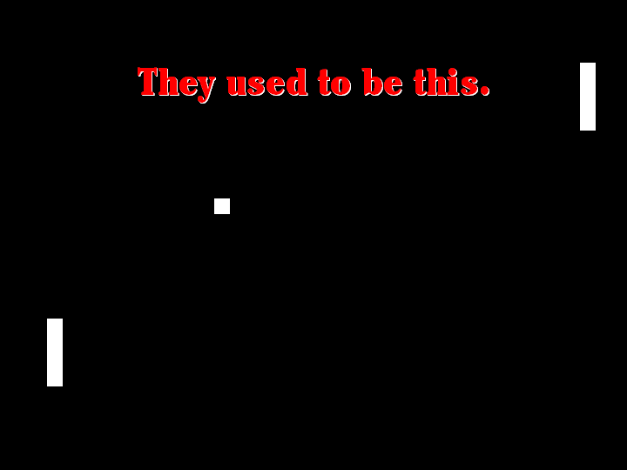
Add-on to increase ‘fun’ & ‘engagement’

Slide 38
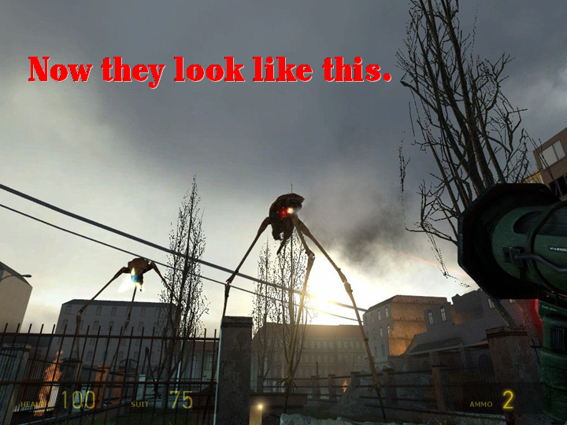
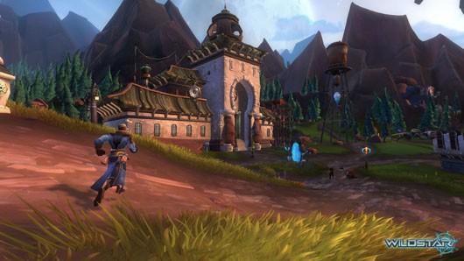

Slide 39
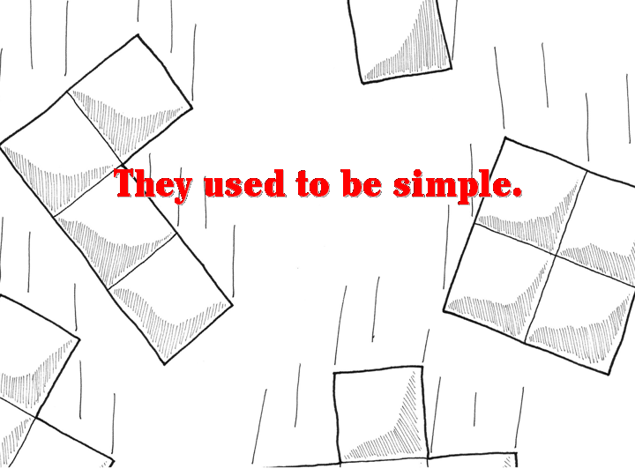

Slide 40





